Slide 1
Incorporating DNA and RNA in one projection
Global sample view plot incorporates RNA rpm and DNA rpm for each microbe in one scatterplot
RNA viruses are isolated on the x-axis
Applying both RNA and DNA enables further separation of outlier organisms in both axes

Slide 3
Mystery Case Examples
1. Chikungunya virus (RNA virus) identified by RNA-seq only, projected on x-axis.
2. Primate tetraparvovirus 1 in high abundance
1. Salmonella enterica identified as an outlier in high abundance.

Slide 4
Algorithms used to identify putative pathogens
Rules-based method:
Identifies outliers within a sample by RNA and DNA-seq
Compares outliers and all RNA-viruses to a list of known pathogens
Will only identify pathogens on the “known pathogens list”
Logistic regression method:
Uses the following features to identify global trends:
RNA rpm
DNA rpm
Rank
Is microbe a known pathogen?
Is microbe a virus?
Can be used to identify novel or uncommon pathogens not on the “known pathogens list”
Charles Langelier, Katrina L Kalantar BiorXiv 2018

Slide 5
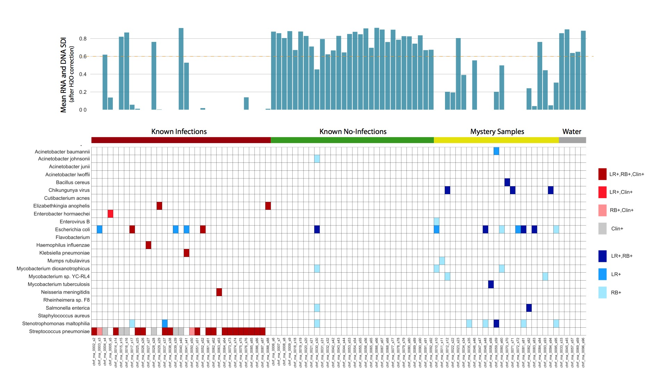
Predicted Pathogens
by Rules-based and Logistic Regression Models
*predictions after applying diversity filter

Slide 6
Extra Slides

Slide 7
